Slide 1
Windows Fundamentals

Slide 2
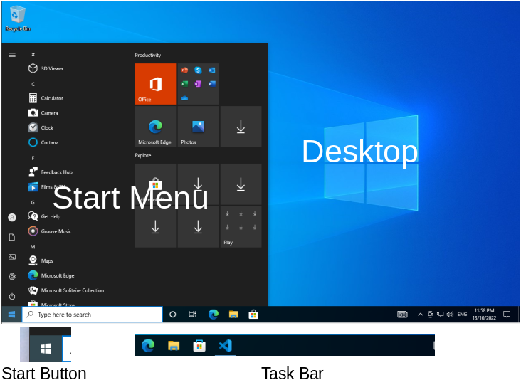
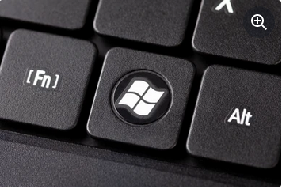
Windows Desktop
Desktop
Start Button
Start Menu
Task Bar
Windows Key

Slide 3
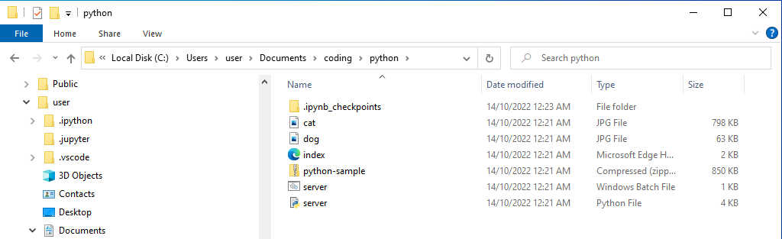
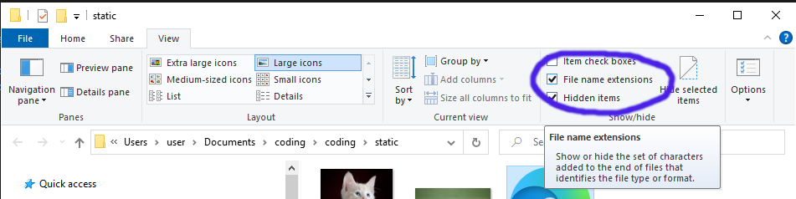
Windows File Explorer
File Explorer allows you to Navigate your C:\ drive.
Enable View File Name Extensions
What is a File?
  A file is an image, a document, a text file, etc
  A file also has some characters after a dot at the end, which is known as the file extension. Windows Hides these by default but we want to see them!
What is a Folder?
  A folder is a collection of files
What is a C:\ Drive?
  The C drive is the ‘hard drive’ inside your computer. It stores all your files and folders

Slide 4
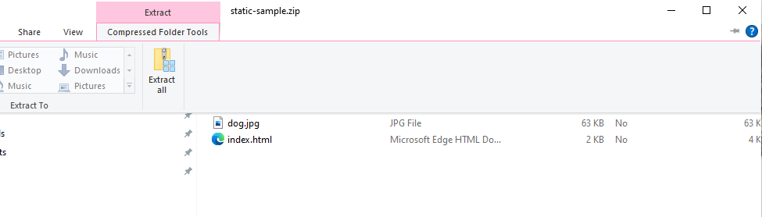
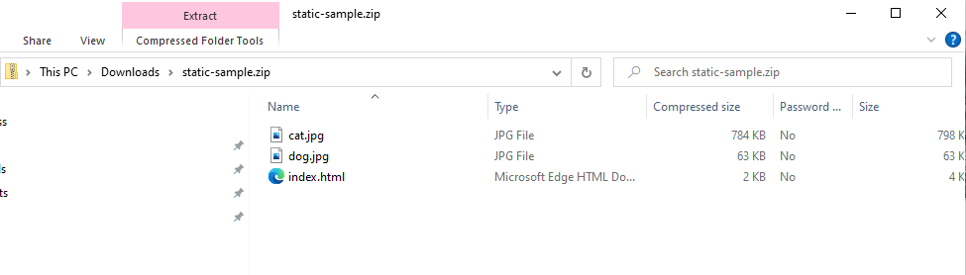
Zip Files
Imagine a ZIP file is a box with books in it, you need to unpack that box to get the books out.
A zip file is like that, you need to unpack it to get the files out.
The static-sample.zip from last week is an example of a zip file.
Windows calls this Unpacking Extract All

Slide 5
Files
There are many types of files including:
  Text files – these are simple files that have characters you can read, like letters, numbers and symbols
  ZIP Files – more on those next
  Images – PNG, JPEG, etc
  Documents – like word, excel documents. These are files only the related application can read and understand
Examples of text files include:
  HTML files – for the internet
  Javascript
  Python
To edit text files we use a Text Editor like Notepad++ or Visual Studio Code.

Slide 6
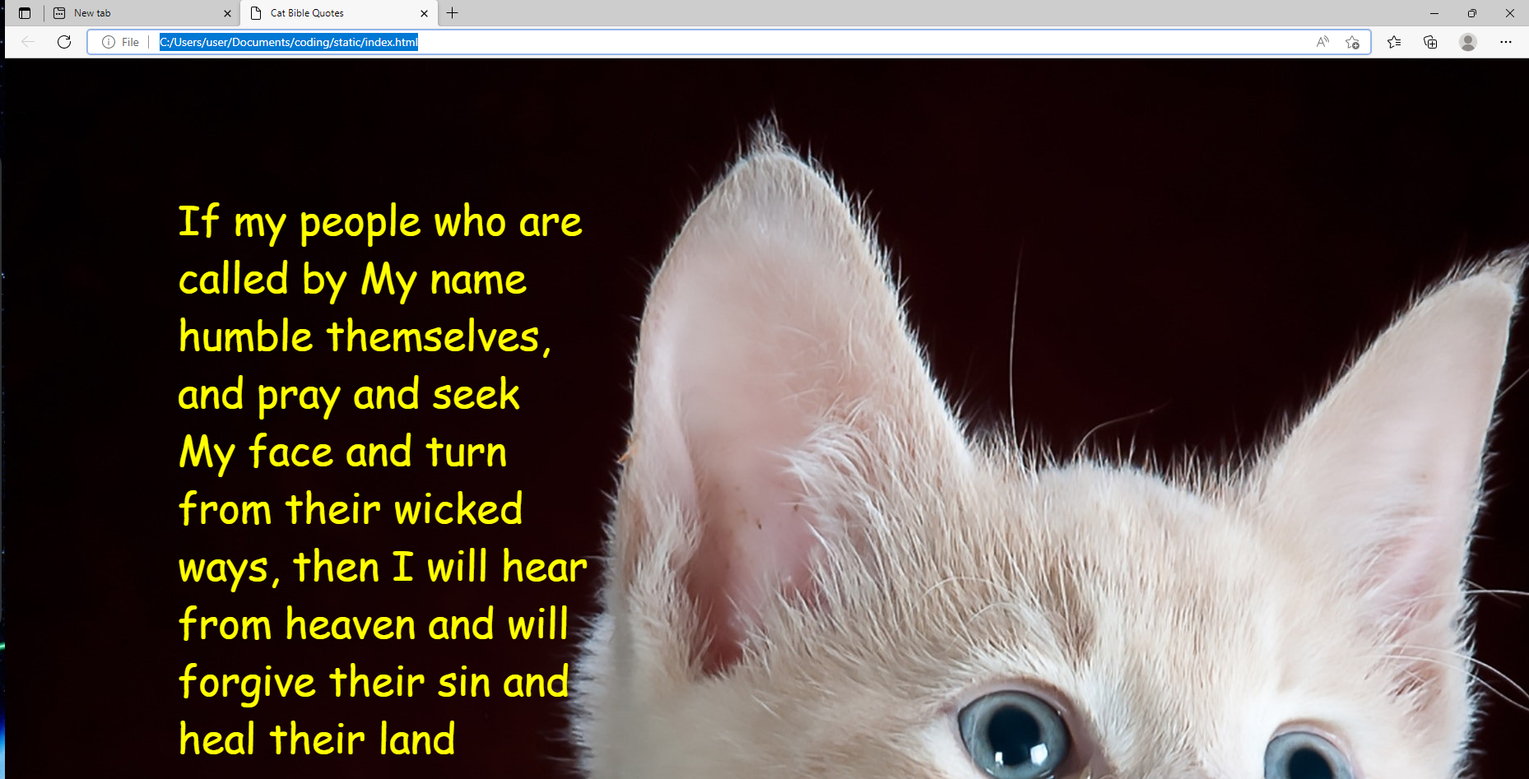
Web Browser
A Web Browser is an application to browse the internet.
Popular browsers include:
  Firefox
  Chrome
  Chromium
  Edge
  Safari
All websites use a type of file called a HTML file.
In addition web sites are constructed using some additonal files such as:
  Images
  JavaScript
  CSS
I won’t go into these here today though!

Slide 7

File Paths and File URLs
File Explorer and Browsers have different ways of referencing local files and folders.
A browser uses a File URL
File Explorer uses a File path
A File URL looks a lot like a File Path, except the slashes are different!
The File URL:
The File Path:

Slide 8
Browser URLs
Browsers use URLs for the internet too
They look a bit different to File URLs though.
There are few parts to a URL:
  The Domain Name
  The Path
  Query Parameters
https://gbc.pellcorp.com/installers/?type=vege&name=carrot
The parts are:
  gbc.pellcorp.com is the domain name
  /installers is the path
  type=vege&name=carrot is the query string, and its everything past the ? Of the URL.
Urls can have ports too:
  http://localhost:8080/quote?type=vege&name=carrot
  localhost is the domain
  8080 is the port
  /quote is that path

Slide 9
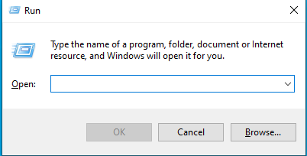
Windows Run Command
Remember the Windows Key?
Windows Key and the R key give you a Run Command window
You can use it to run applications if you know their name.
We will use it next to run the Windows Terminal
Lets start Notepad using the Run Command. Type ‘notepad’ and hit the Enter / Return key.

Slide 10
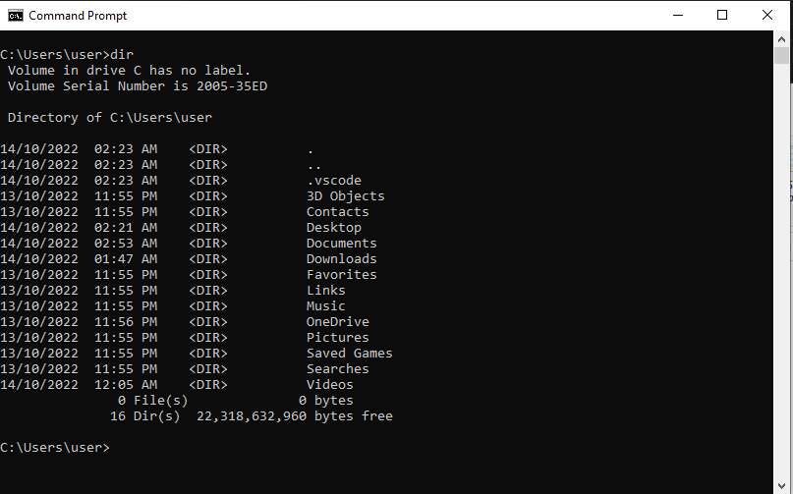
Windows Terminal
The CMD terminal is where you can run applications by typing their name
Use the Run Command window, type ‘cmd’ and hit enter.
With Terminal you can navigate your C:\ drive just like with File Explorer
Some common commands include:
  dir – to display folder contents (give it a try, type ‘dir’ by itself
  cd <folder name> to change to a different folder
  type <filename> - to display what is inside a file

Slide 11
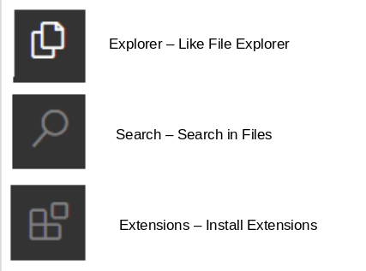
Visual Studio Code (VSC)
Visual Studio Code is also a text editor
But it also makes it easy to run our python programmes directly.
There a few important parts of Visual Studio Code you should familiarise yourself with.
Important buttons:
Don’t worry too much about the others for now

Slide 12

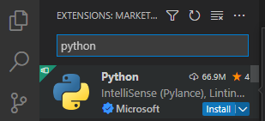
Add the Python Extension
Start up Visual Studio Code
Click the Extensions button
Search for python and click the install button
And then Wait for it to finish installing
And that is it, once its done we will be able to do some python coding!

Slide 13

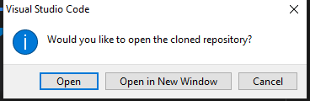


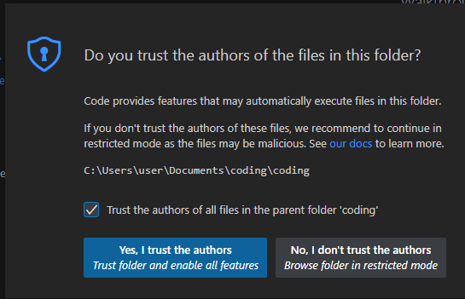

Getting the Sample Code
Click the Explorer button
Click the Clone Repository button
Enter the following URL:
https://github.com/pellcorp/coding.git
Hit that Enter key to continue
Choose your School Drive folder and then click the button.
Click Open when prompted to Open the repository
Click the Yes, I trust the authors button.

Slide 14
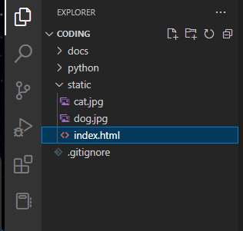
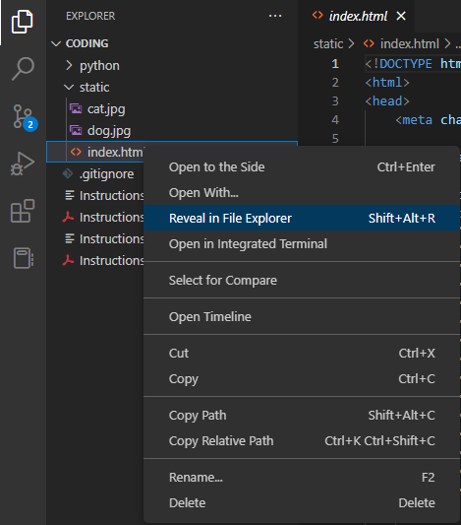
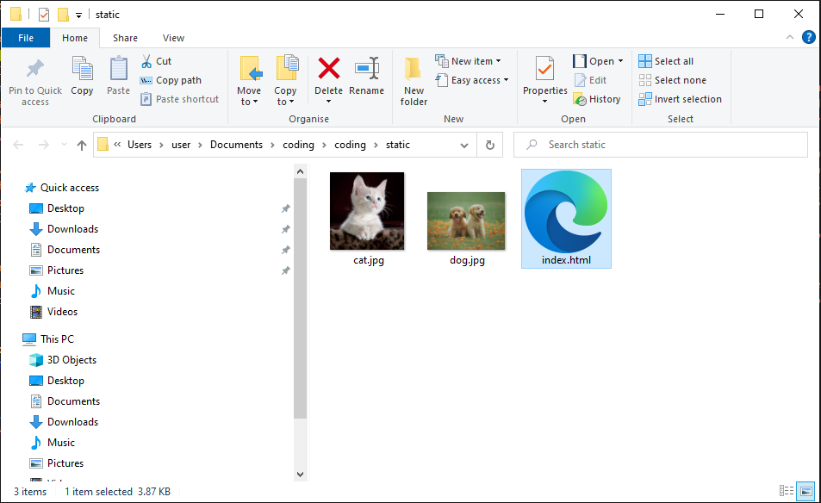
The Sample Code
A handy feature of VSC is to Reveal a selected file in File Explorer.
You should see this now:

